Slide 1
Natural Language Processing (NLP)
Renato R. Maaliw III, DIT
College of Engineering
Southern Luzon State University
Lucban, Quezon, Philippines

Slide 2
NLP
An area of computer science & artificial intelligence concerned with the interactions between computers and human (natural) languages.
Particular on how to program computers to process and analyze large amounts of natural language data.

Slide 3
When performing analysis, lots of data is numerical (sales numbers, physical measurements, quantifiable categories)
Computers are very good at handling direct numerical information
But what do we do about text data?

Slide 4
As humans we can tell there is a lot of information inside of text documents
However, a computer needs specialized processing techniques in order to “understand” raw text data.
Text data is highly unstructured and can be in multiple languages.

Slide 5
NLP attempts to use a variety of techniques in order to create a structure out of text data
We will discuss (first) some of the techniques using libraries such as Spacy and NLTK

Slide 6
Use Cases of NLP:
Classifying emails as spam vs. legitimate
Sentiment analysis of text movie reviews
Analyzing trends from written customer feedback forms
Understanding text commands, “Hey Google, play this song”

Slide 7
NLP is constantly evolving and great strides are made every month.
In this lessons, we will focus on the fundamental ideas that all state-of-the-art techniques are based off
We will learn about the basics of using the Spacy library.

Slide 8
Spacy Basics

Slide 9
Loading the language library
Building a pipeline object
Using tokens
Parts-of-Speech tagging
Understanding token attributes

Slide 10
The nlp() function from Spacy automatically takes raw text and performs a series of operations to tag, parse, and describe the text data.

Slide 11
We will create a pipeline objects and its series of operations
Examples: Tokenization, POS, Stemming, Lemmatization, etc.

Slide 12
Tokenization

Slide 13
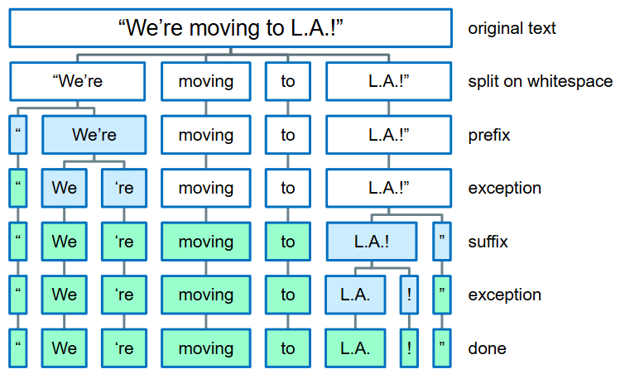
Tokenization is the process of breaking up the original text into component pieces (tokens)

Slide 14
Notice that tokens are pieces of the original text
We don’t see any conversion to word stems or lemmas (base forms of words) and we haven’t seen anything about organizations/places/money etc.

Slide 15
Prefix: character(s) at the beginning → $ ( “
Suffix: characters(s) at the end → km ) , . ! “
Infix: character(s) in between → - -- / …
Exception:
special-case rule to split a string into several tokens
or prevent a token from being split when punctuation
rules are applied → let’s U.S.

Slide 16
Tokens have a variety of useful attributes and methods

Slide 17
Tokenization Visualized

Slide 18
Visualization of token relationships

Slide 19
Stemming

Slide 20
Often when searching text for a certain keyword, it helps if the search returns variations of the word
For example, searching for “boat” might also return “boats” and “boating”. Here “boat” would be the stem for [boat, boater, boating, boats]

Slide 21
Why Stemming is Necessary?
1. Text Normalization
Words like running, runs, and ran share the same root (run). Stemming reduces these inflections and derivations to a common base form, making it easier to treat them as the same word.
This simplifies text data by reducing redundant word variations.

Slide 22
Why Stemming is Necessary?
2. Improves Search and Matching
In search engines or databases, stemming allows a query for run to return documents containing runs, running, or ran.
It improves the recall of search results by accounting for morphological
variations.

Slide 23
Why Stemming is Necessary?
3. Reduces Dimensionality
By grouping different forms of a word into a single base form, stemming reduces the size of the vocabulary.
This is especially useful in machine learning and NLP tasks, where large vocabularies increase computational complexity.

Slide 24
Why Stemming is Necessary?
4. Enhances Machine Learning Models
Helps algorithms focus on the meaning of the word rather than its grammatical variations.
Reduces noise and sparsity in feature space, improving the performance of models like text classifiers or topic models.

Slide 25
Why Stemming is Necessary?
5. Essential for Languages with Rich Morphology
For languages with complex inflections (e.g., Finnish, Turkish), stemming simplifies words to their root forms, making analysis feasible.

Slide 26
Why Stemming is Necessary?
6. Improves Clustering and Similarity
In clustering or similarity-based tasks, stemming ensures that words with similar meanings are grouped together.

Slide 27
Without Stemming:
Words: run, running, runner, runs
Vocabulary: ['run', 'running', 'runner', 'runs']
After Stemming:
Words: run, run, run, run
Vocabulary: ['run']
* This reduction ensures that all variations are treated as one, improving both efficiency and consistency.

Slide 28
Limitations:
Over-stemming: Some stemmers may cut too much, merging unrelated words (e.g., universe and university both reduced to univers).
Loss of Meaning: Stemming does not preserve the context or precise meaning of words, as it focuses on root forms.
Modern Alternative: Lemmatization, a more sophisticated approach, considers the context and grammar of a word to return its proper dictionary form.

Slide 29
In fact, SpaCy doesn’t include a stemmer, opting instead to rely on lemmatization.
Because of this, we will jump over to using NLTK and learn about stemmers.
Porter Stemmer and Snowball Stemmer

Slide 30
Porter Stemmer

Slide 31
Porter Stemmer employs five phases of word reduction, each with its own set of mapping rules.

Slide 32
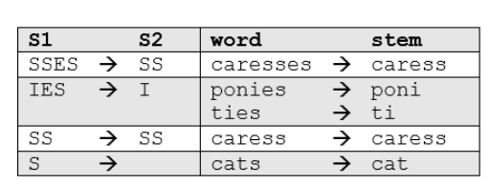
In the first phase, simple suffix mapping rules are defined, such as:

Slide 33
From a given set of stemming rules only one rule is applied, based on the longest suffix S1. Thus, caresses reduces to caress but not cares

Slide 34
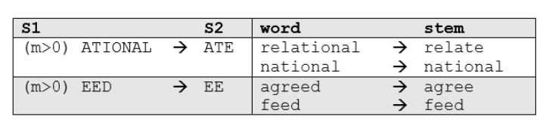
More sophisticated phases consider the length/complexity of the word before applying a rule.

Slide 35
Snowball Stemmer

Slide 36
Snowball Stemmer used a more accurate “English Stemmer” or “Porter2 Stemmer”
Offers a slight improvement over the original Porter stemmer, both in logic and speed

Slide 37
Lemmatization

Slide 38
In contrast to stemming, lemmatization looks beyond word reduction, and considers a language’s full vocabulary to apply a morphological analysis to words.
Generally better as it returns the dictionary form of a word (lemma) while considering context and part of speech (POS). Unlike stemming, it avoids over-simplifying words and ensures the output is meaningful and accurate.

Slide 39
Feature | Stemming | Lemmatization
Definition | Cuts the word to its root, often a crude form. | Reduces a word to its base form (lemma) using context.
Context-Sensitivity | Ignores context and parts of speech (POS). | Considers context and POS for accuracy.
Output | May produce non-existent or incorrect words. | Always produces valid dictionary words.
Examples | Caring → car | Caring → care

Slide 40
Example 1. Handling Verb Forms
Word | Stemming | Lemmatization (POS: Verb)
running | run | run
ran | ran | run
runs | run | run
* Why better? Lemmatization recognizes all verb forms and reduces them to the base form (run)

Slide 41
Example 2. Handling Nouns
Word | Stemming | Lemmatization (POS: Nouns)
geese | gees | goose
feet | feet | foot
* Why better? Lemmatization uses dictionary rules to handle irregular nouns.

Slide 42
Example 3. Avoiding Over-Stemming
Word | Stemming | Lemmatization (POS: Verb)
organization | organ | organization
organize | organ | organize
* Why better? Stemming cuts too aggressively, losing meaning, while lemmatization retains proper forms.

Slide 43
Example 4. Context Sensitivity
Word | Stemming | Lemmatization
He is building a house. | He is build a house | He is building a house.
They build houses | They build house. | They build houses
* Why better? Lemmatization retains proper inflection and pluralization based on sentence context.

Slide 44
Advantages of Lemmatization over Stemming
Accuracy: Produces correct dictionary words and considers POS tags.
Context Awareness: Handles irregular forms and context-sensitive words.
Readability: Outputs meaningful words suitable for downstream tasks like summarization or translation.

Slide 45
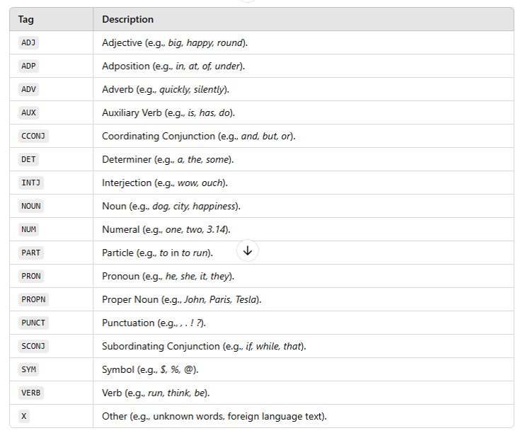

Slide 46
Stop Words

Slide 47
Stop words are common words in a language (e.g. the, is, in, and) that are frequently filtered out in text processing because they are often not significant for tasks like information retrieval, text classification, or sentiment analysis.
They are frequent but do not contribute much meaning to the overall text

Slide 48
Spacy holds a built-in list of English stop words
Common English Stop Words
- is, are, the, a, an, of, in, on, and, it, to.

Slide 49
Example:
“The quick brown fox jumps over the lazy dog.”
With Stop Words:
“quick brown fox jumps over the lazy dog.”

Slide 50
Vocabulary and Matching

Slide 51
We will identify and label specific phrases that match patterns that we can define ourselves
We will take parts of speech into account for our pattern search

Slide 52
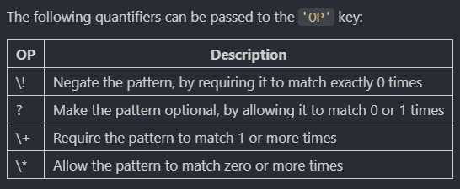

Slide 53
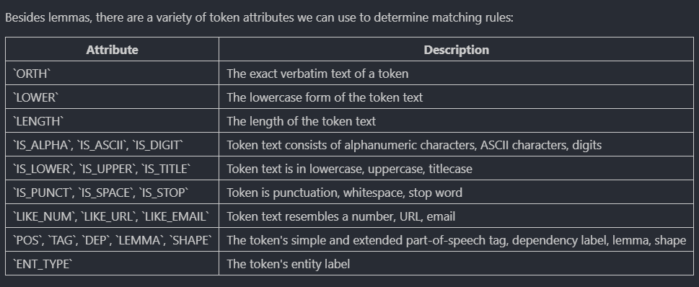

Slide 54
Thank you very much for listening.

